Slide 1





Web Map
Get started
25 April 2018 Developer Workshop

Slide 2




Agenda
Prepare Data
Develop Web App
Exercise

Slide 3
Resources Link
https://github.com/tospol/Developer-workshop-1

Slide 4

Prepare Data
ArcGIS Online

Slide 5
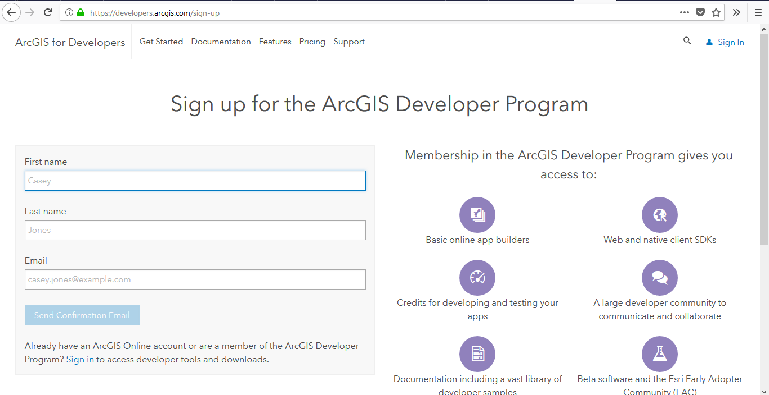
Developers.arcgis.com/sign-up

Slide 6
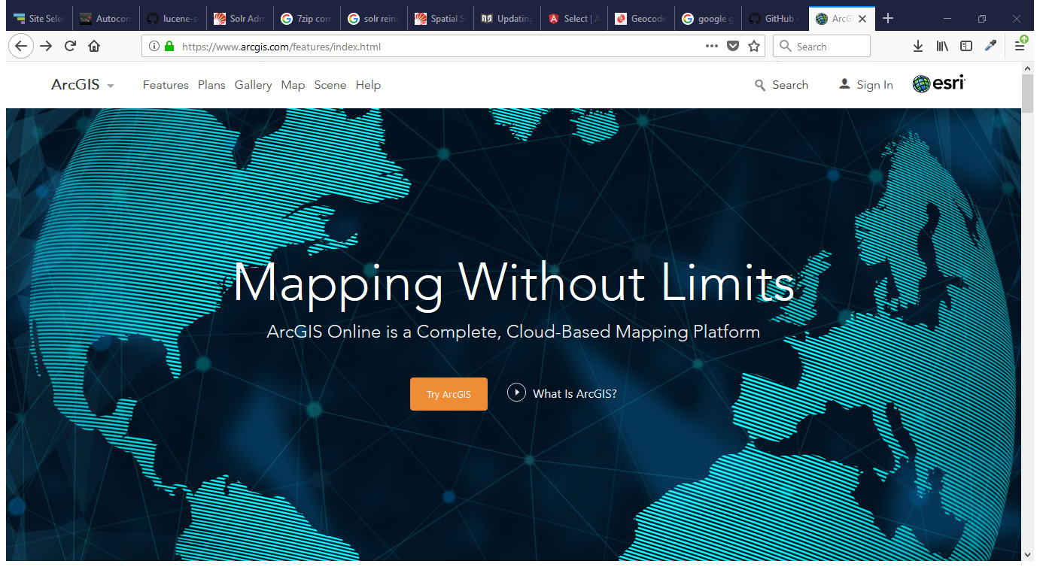
ArcGIS.com

Slide 7
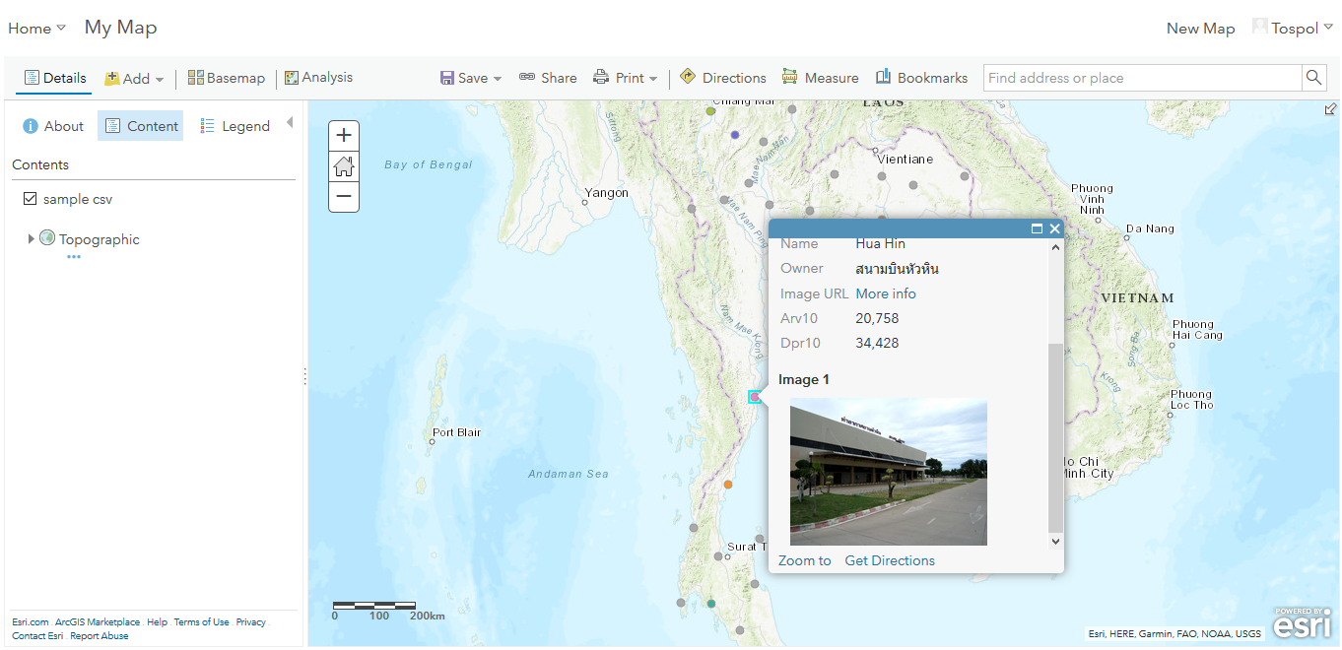
Content & Map

Slide 8
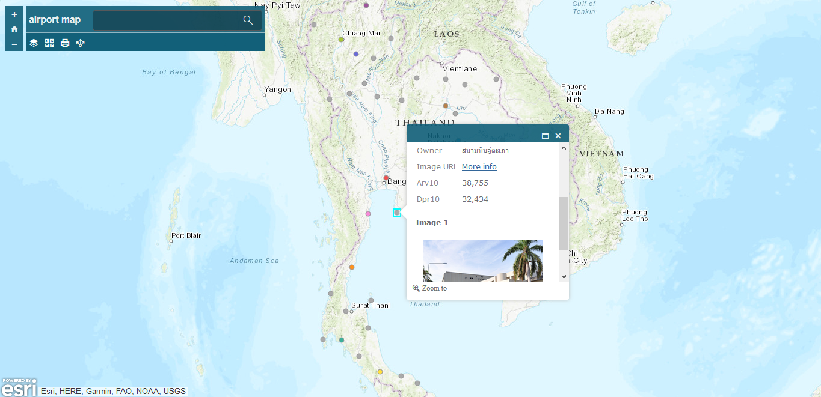
Ready to use App

Slide 9
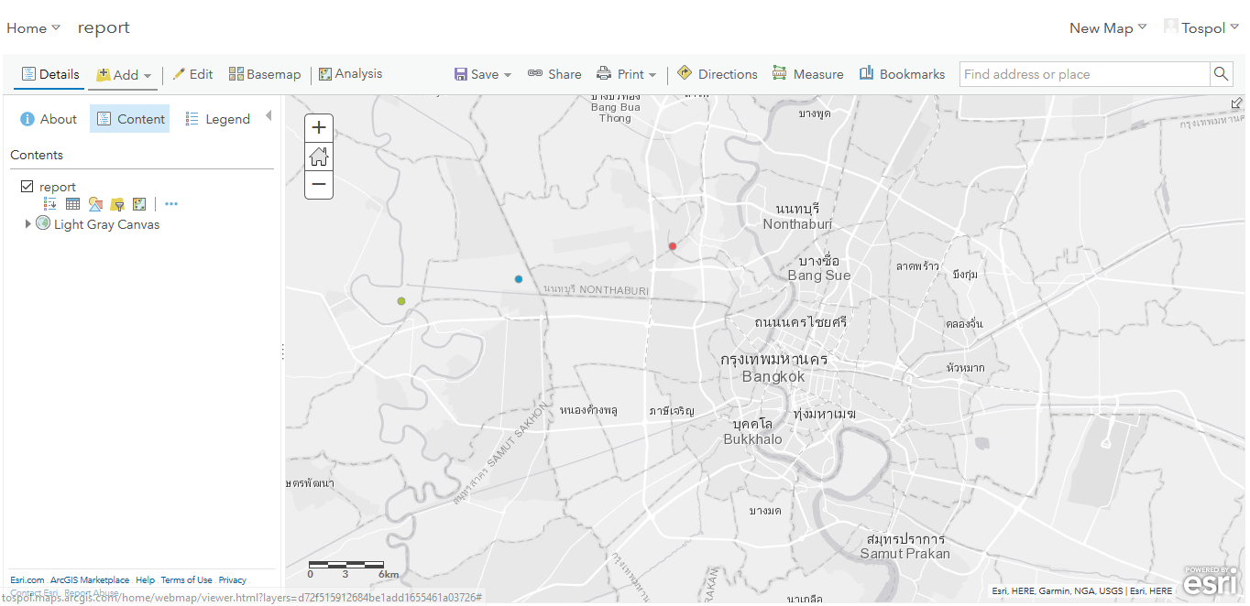
Create your data

Slide 10
Create your data
ArcGIS.com
Content > Create > Feature Layer
Choose template
Manage fields (Data tab)
Add sample data
Configure Visualization

Slide 11
Create your data
ArcGIS for developer
Dashboard + New Layer
Create an empty layer
Add sample data
Configure Visualization

Slide 12
Develop Web App
ArcGIS API for JavaScript

Slide 13
Mapping Concept
Layers
- GraphicLayer
- FeatureLayer
- Basemap
Map
Feature/Graphic
- Geometry
- Attributes
- Symbol
Geometry ⬄ Symbol
- Point ⬄ SimpleMarker, PictureMarker
- Polyline/Line ⬄ SimpleLine
- Polygon ⬄ SimpleFill

Slide 14
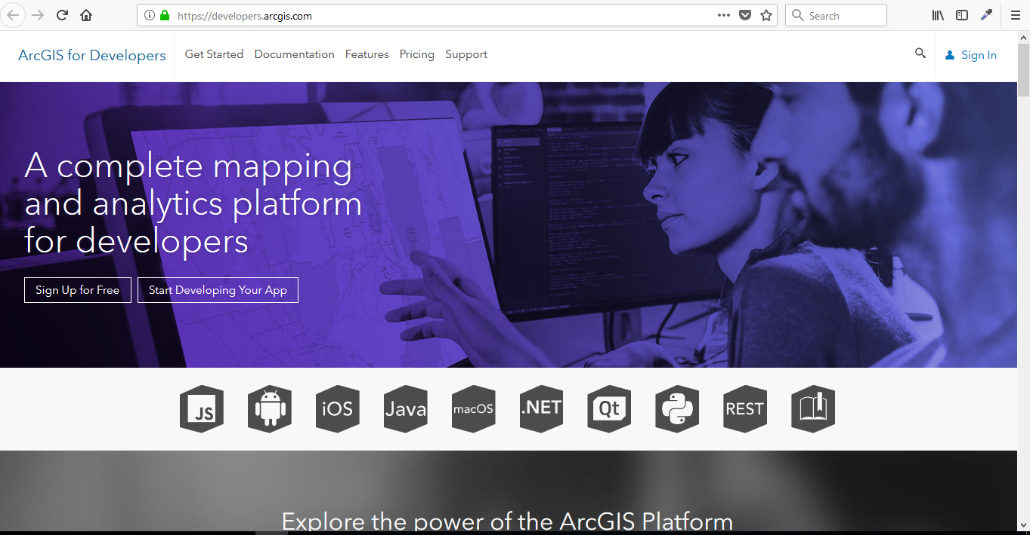
Developers.ArcGIS.com

Slide 15
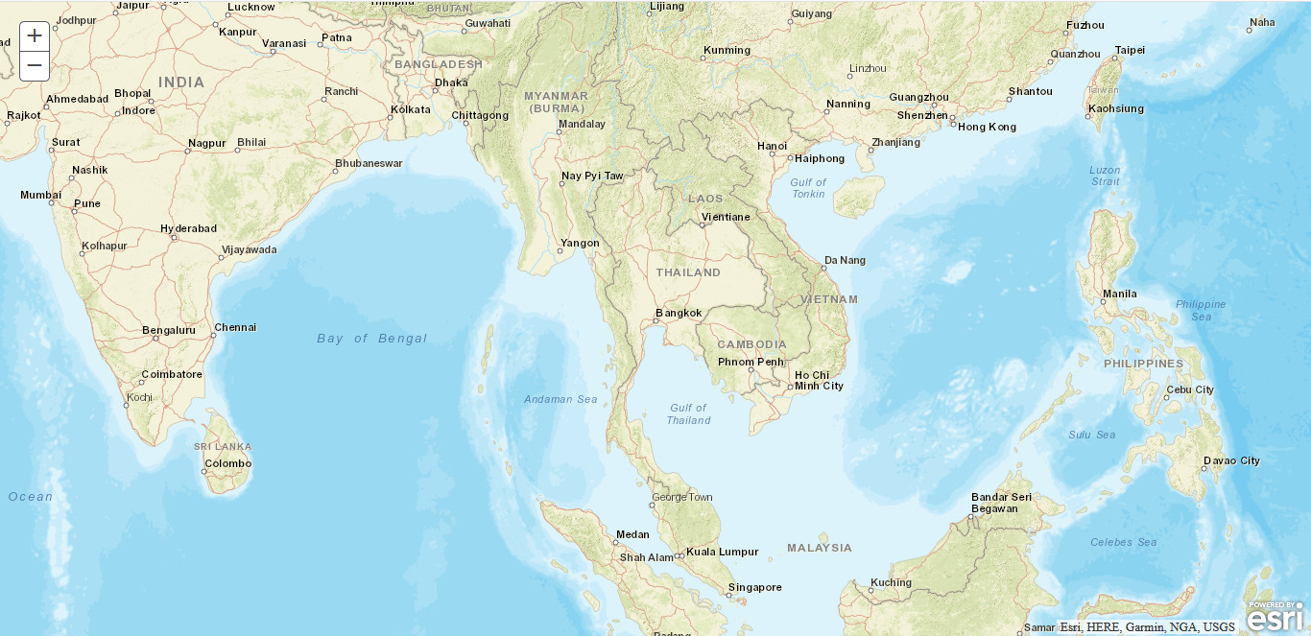
Hello World

Slide 16
Hello World
Create a Simple HTML Document
Reference the ArcGIS API for JavaScript
Load Modules
Ensure the DOM is Available
Create the Map
Define the Page Content
Style the Page

Slide 17
Hello World
Change basemap to ภาพถ่ายดาวเทียม
Starting location at Thailand
Lat : 13, Lon : 100

Slide 18
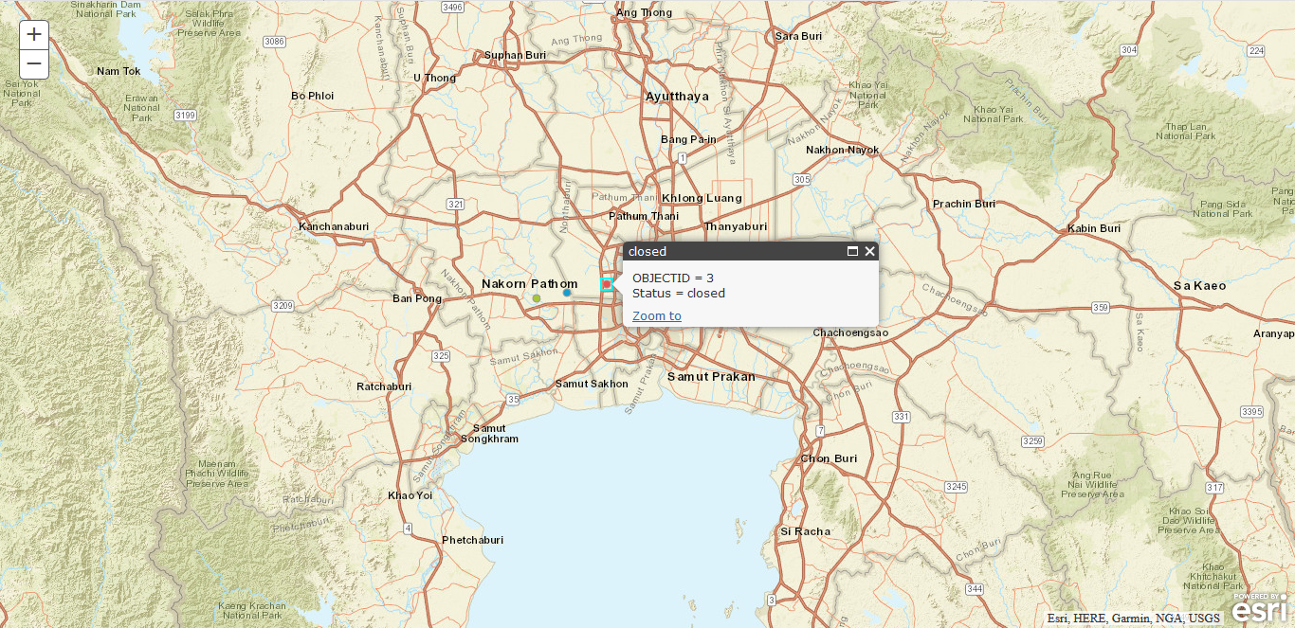
Add Layer

Slide 19
Add Layer
Map
Method: addLayer(Layer)
FeatureLayer
Constructor: FeatureLayer(url,options{})
InfoTemplate
Constructor: InfoTemplate(title,content)

Slide 20
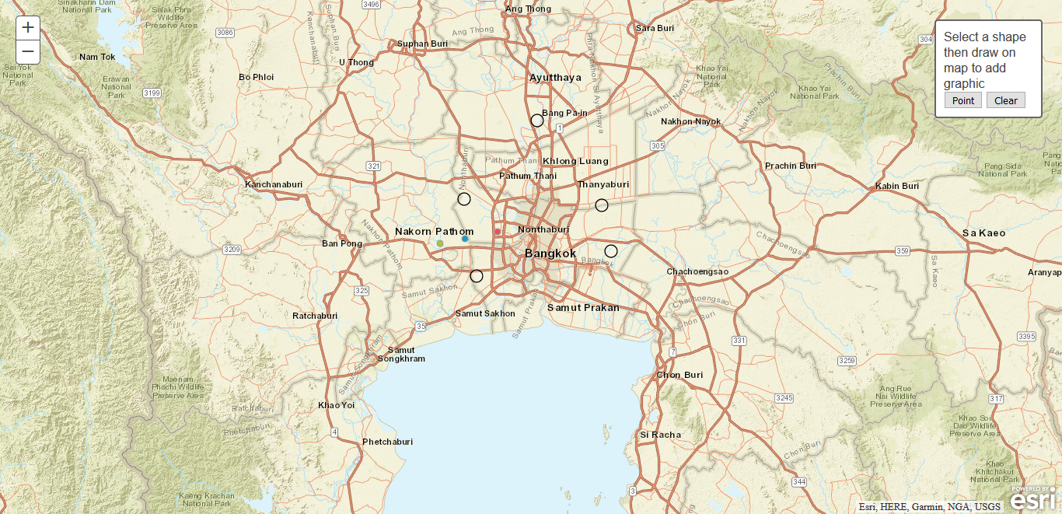
Add Graphics

Slide 21
Add Graphics
Graphic
Geometry
Symbol
Map
graphics property
GraphicsLayer
add method
clear method

Slide 22
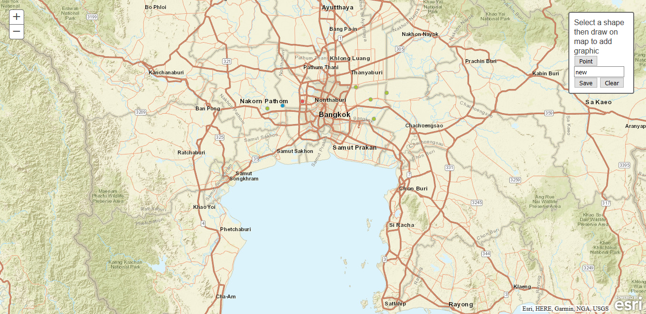
Add Data

Slide 23
Add Data
FeatureLayer
applyEdits method
refresh method
Graphic
geometry
attributes
clone method
setAttributes method

Slide 24

THANK YOU
Developer Workshop
25 April 2018

